Slide 1


Slide 2
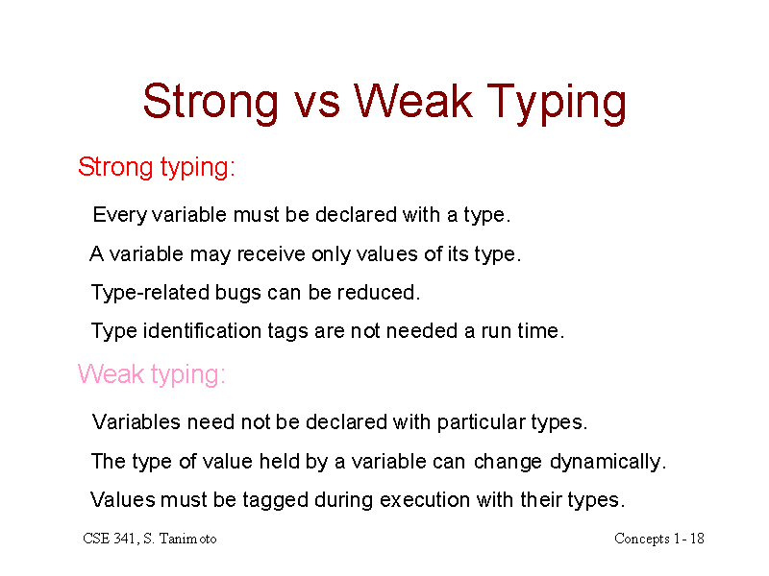

Slide 3
Type Checking & Its Importance ?
Type checking is the process of verifying and enforcing the constraints of types, and it can occur either at compile time (i.e. statically) or at runtime (i.e. dynamically).
Type checking is all about ensuring that the program is type-safe, meaning that the possibility of type errors is kept to a minimum.
A type error is an erroneous program behavior in which an operation occurs (or try to occur) on a particular data type that it’s not meant to occur on. For e.g. This could be a situation where an operation is performed on an integer with the intent that it is a float, or even something such as adding a string and an integer together: int x = 10 + “Ali” ;

Slide 4
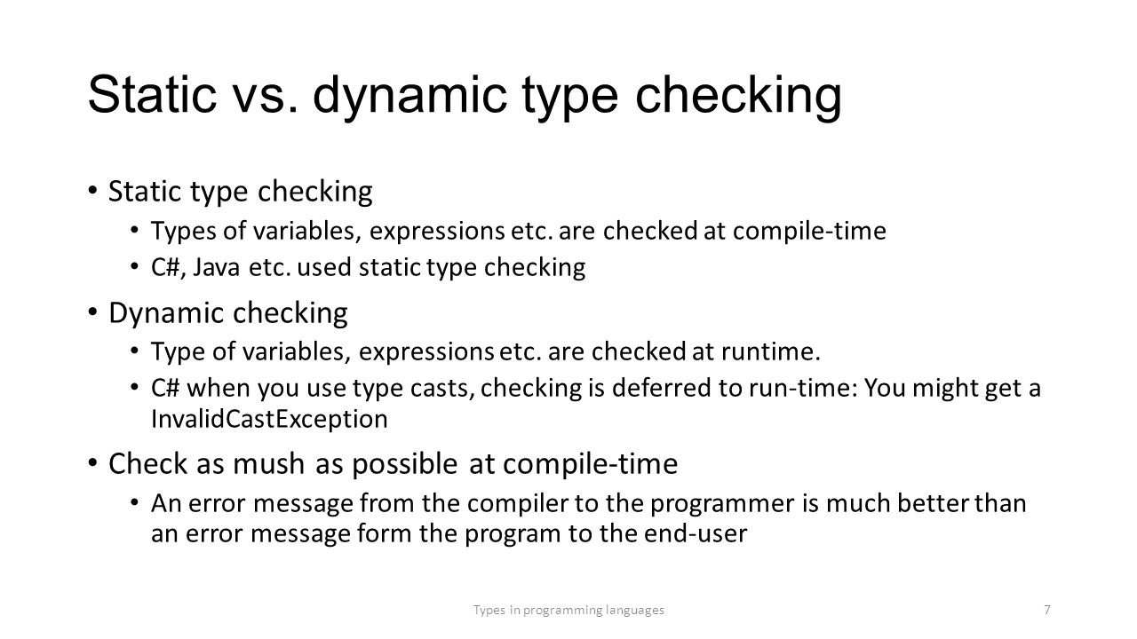

Slide 5
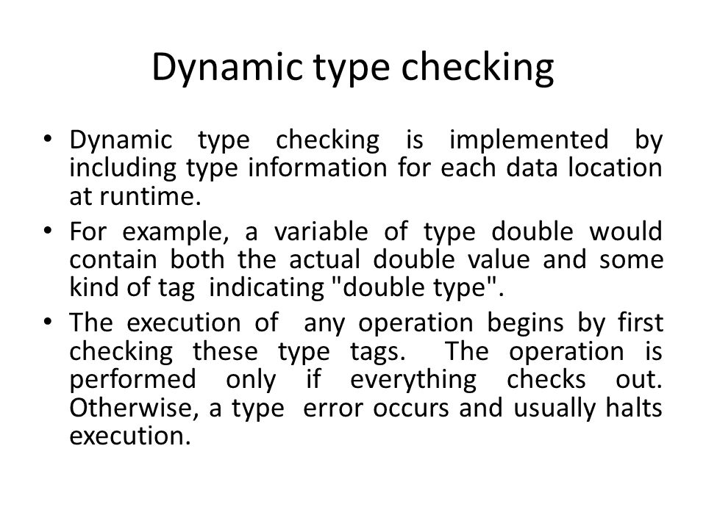

Slide 6
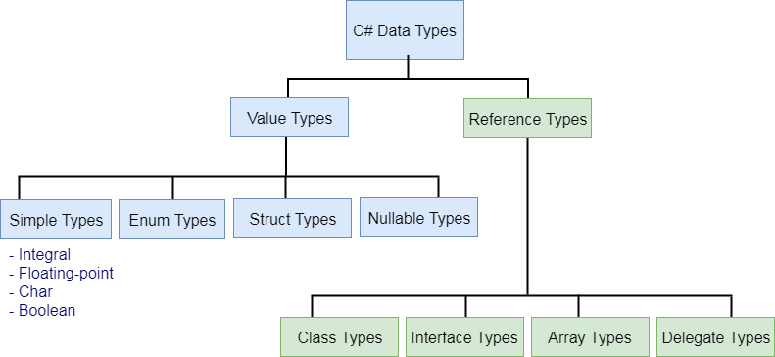

Slide 7
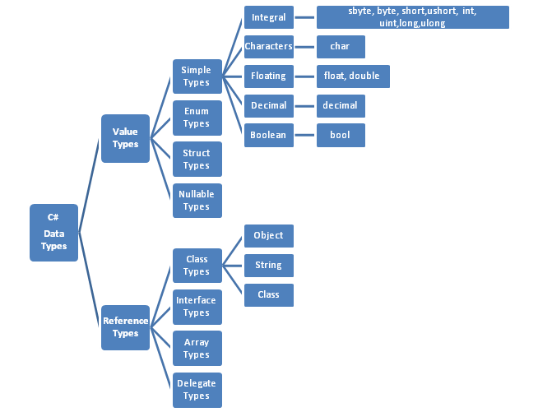

Slide 8
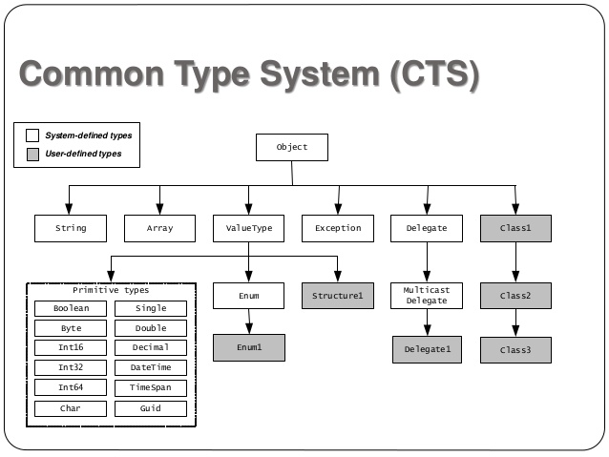

Slide 9
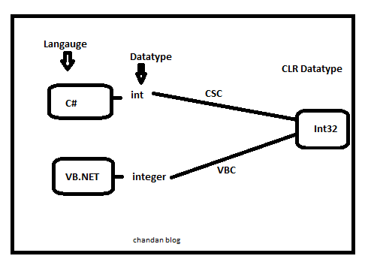
Common Type System CTS In .NET

Slide 10
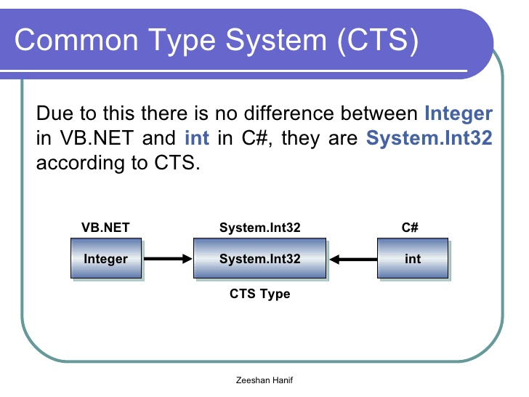

Slide 11
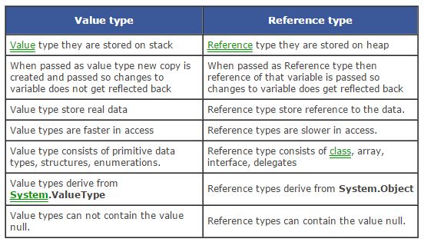

Slide 12
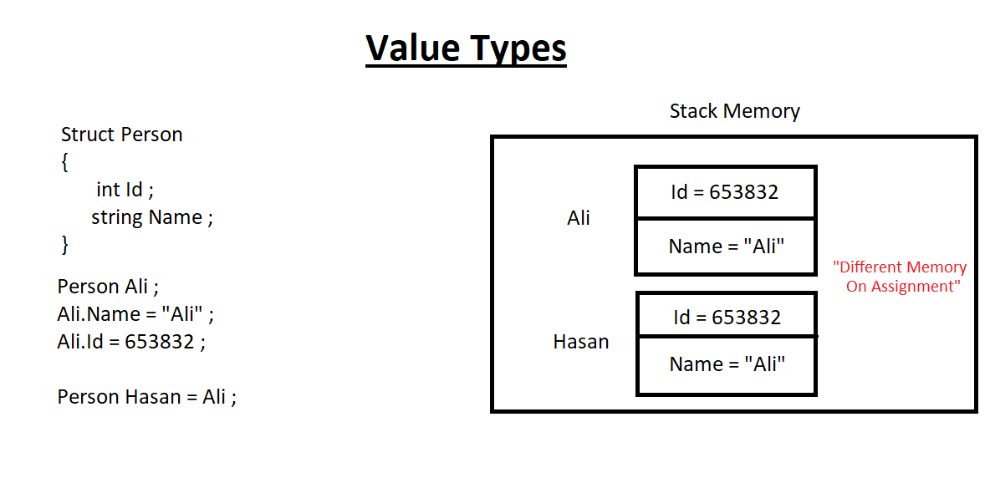

Slide 13
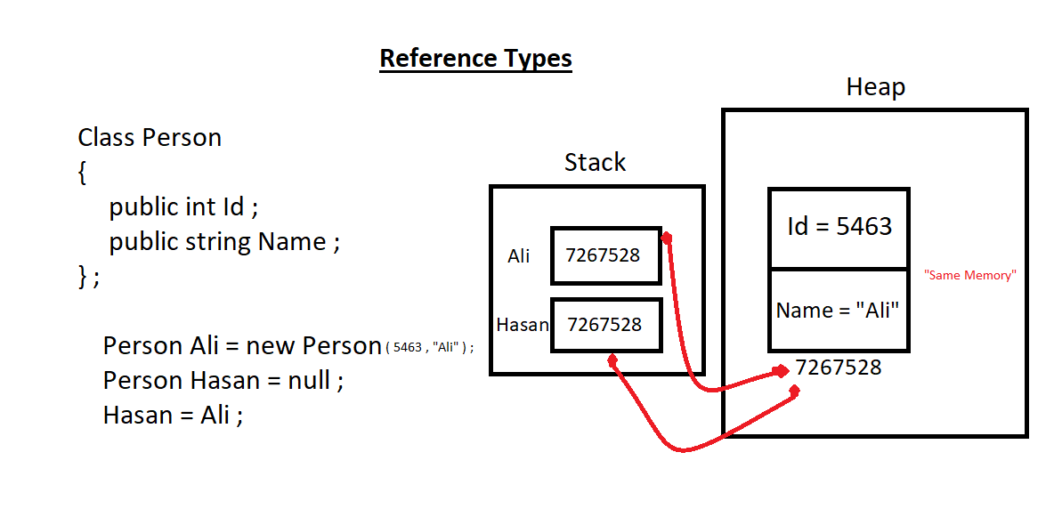

Slide 14
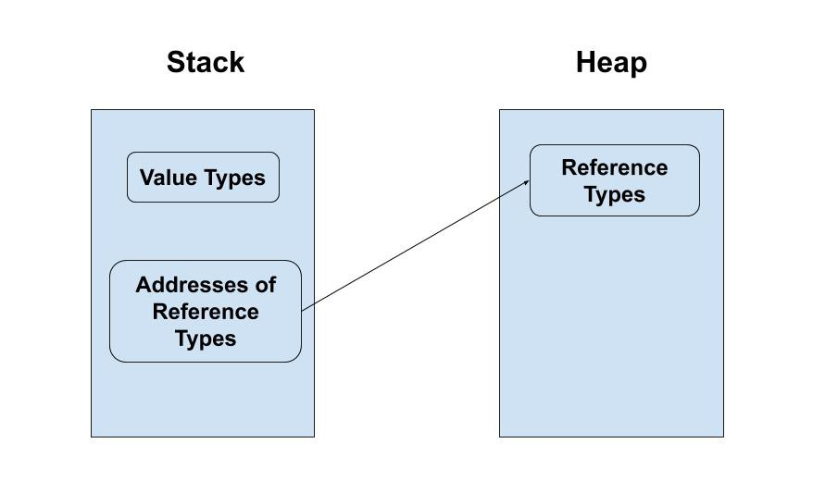

Slide 15
Size Of Reference Variables VS Size Of Memory Block In Heap
- The memory space used by a pointer or a reference generally depends on the type of system i.e. 32 bit or 64 bits. A pointer stores the address of a variable. Now the address bits needed will depend upon the computer architecture, i.e. 32 bits have 4 byte memory for pointers and 64 bits take 8 bytes.
- The memory space used by a block is dependent on the total value types it has.

